Slide 1
3-6C
Term 3, Week 1

Slide 2
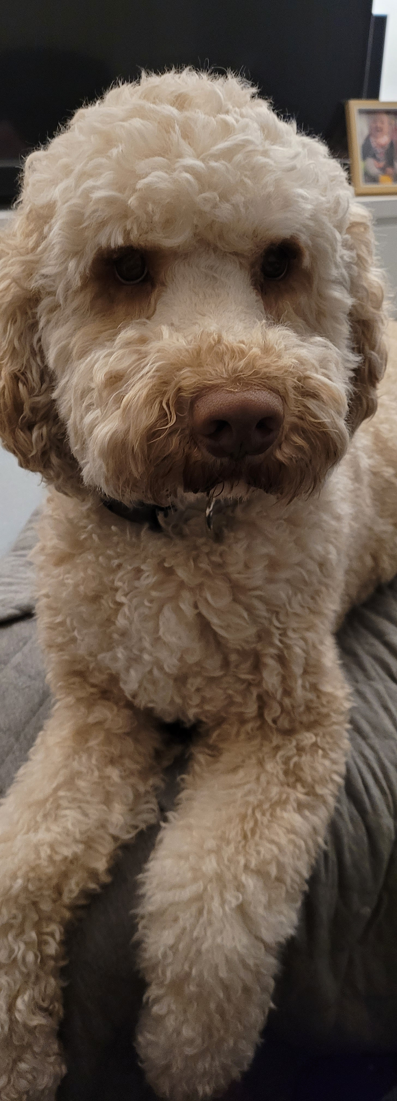
Hello from ms carter!
Hi Brock, Mark and Syrus!
I hope you have had a wonderful holiday, even though we had to spend most of our time at home.
I got to spend lots of time with my dog, Dougal. He has been very happy to have me at home. We also enjoyed getting out into the garden.
If you need to contact me during Week 1 or just want to say hello, you can post on the wall of our Google Classroom. You could also send me an email. I’ll be available 9am until 3pm to answer any questions you have.
I can’t wait to be back with you in our classroom as soon as possible!
From Ms Carter email: olivia.carter@det.nsw.edu.au

Slide 3
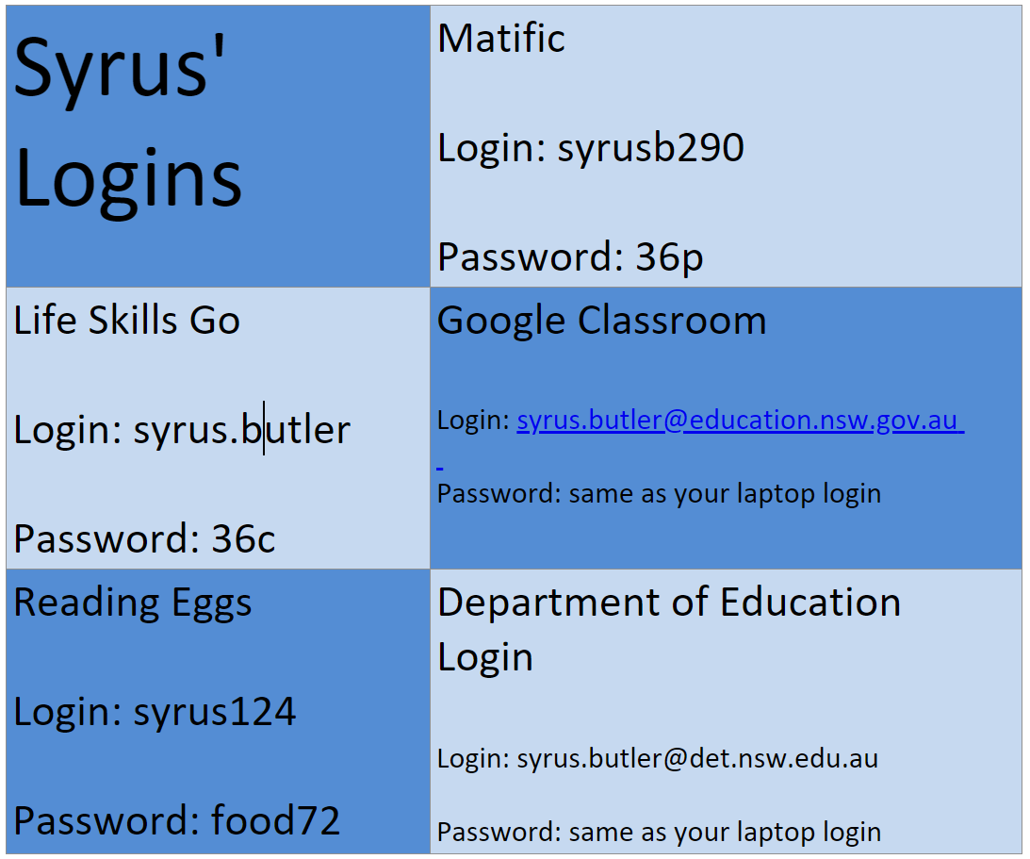
Syrus’ logins

Slide 4
Brock’s logins

Slide 5
Syrus’ logins
Mark’s logins

Slide 6
A Riddle a day
Tuesday: What always falls without getting hurt?
Wednesday: What do you get when you cross a cheetah and a hamburger?
Thursday: What is full of holes yet can still hold water?
Friday: Why do mother kangaroos hate rainy days?
Post your answers on Google Classroom and check the last page for the answers!

Slide 7
Matific and reading eggs
Login to Matific and Reading Eggs for 20 to 30 minutes each day and complete the activities I have left for you.
https://readingeggs.com.au/
https://www.matific.com/au/en-au/login-page/

Slide 8
Get active!
Tuesday
Create an obstacle course in your back yard. Time yourself moving through your obstacle course. In your workbook, record your times using minutes (m), seconds (s) and milliseconds (ms).
Wednesday
Dribbling is the skill of moving a ball forwards with slight touches of the ball with your feet. Dribble a ball in your back yard.
Thursday
Go for a walk with your family and take photographs of some signs you see that are designed to keep you safe.
Friday
Practise running, jumping and skipping.

Slide 9
Life skills
Tuesday:
Make yourself a sandwich for lunch. In your workbook, write or draw the ingredients you added to your sandwich.
Wednesday:
In your workbook, name 3 ways you can keep yourself safe when riding your bike.
Thursday:
Take a photo or draw a picture in your workbook of some signage in your house or in your neighbourhood that is designed to keep you safe.
Friday:
Help a family member prepare dinner. Take a photo of what you made and post it to Google Classroom or draw a picture in your workbook.

Slide 10
Get Creative!
Tuesday: Draw a picture of your favourite toy in your workbook. In your workbook, write about why you love it.
Wednesday: Have a go at doing some origami. Try to remember some of the origami folding we did last term or with your parents help, use Youtube to find some more origami designs. Take a photo and post your designs to Google Classroom or draw a picture in your workbook.
Thursday: On your walk with your family, collect or take a photo of a range of items you find that match the following colours/ shades; red, blue, yellow and black. If you can’t go for a walk, choose things from your house of yard.
Friday: Use the coloured paper provided to cut out small coloured squares to make a Minecraft character of your choice.

Slide 11
A Riddle a day: ANSWERS
Tuesday: Rain!
Wednesday: Fast Food!
Thursday: A Sponge!
Friday: Because the kids have to play inside!

